Slide 1
Access Oak Ridge
an Introduction to
Notes:
Good evening and thank you very much for joining us this tonight.
As most of you know, digital literacy has become increasingly essential in preparing students for college and career readiness in today’s world.
The realities of the 21st century include widespread technology integration in both higher education and the workplace.
As such, students must be prepared to compete in a rapidly-changing, global economy that requires new skills.
As part of its commitment to raising student achievement, ORS leadership has emphasized digital adoption and made significant progress to this end over the past several years.
Digital adoption is critical to keeping and attracting the top educators to school districts, as well as attracting area businesses and families choosing schools for their children.
In order to meet the challenges of tomorrow – and fully realize the benefits of digital adoption – ORS is rolling out its digital 1:1 initiative to put technology in the hands of every student.
Digital 1:1 initiatives enable schools to incorporate cutting-edge technology in and out the classroom.
This investment will enrich the growth of ORS students and staff, and allow them to reap the harvest digital learning and leveraging new technologies both in and out of the classroom.
Today, we are excited to formally introduce you to our digital 1:1 initiative: Access Oak Ridge.

Slide 2
Today’s Agenda for Device Deployment
Check In
Attend Opening Session
Device policies
Internet Safety & Digital Citizenship
Device Paperwork Submission
Device Pick up
Test Device and Programs Log-in

Slide 3
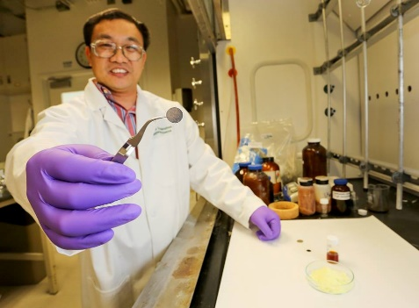
Steeped in History
OAK RIDGE, TENNESSEE…
Manhattan Project
U.S. Atomic Energy Commission
U.S. Department of Energy
Oak Ridge National Laboratory
Y-12 National Security Complex
Oak Ridge Associated Universities
Science, Technology, Engineering, and Mathematics
Notes:
Oak Ridge, Tennessee, also known as Secret City or Atomic City, USA, is a city noted for its history.
Our legacy is that of the (read through third bullet, fifth sub-bullet).
Simply put, Oak Ridge is steeped in a rich history of excellence in science, technology, engineering and mathematics
At ORS, we are part of that rich history.
As such, we mean to lead the charge for 21st century learning – and we believe our rich history requires us to do so.

Slide 4
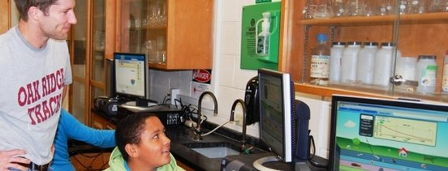
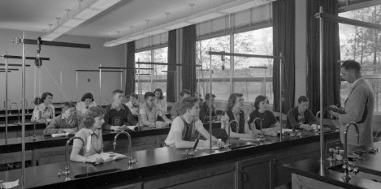
Oak Ridge Schools (ORS)
EXCELLENCE IN EDUCATION SINCE 1943…
“The children who were placed in (ORS) by scientists, engineers, craftsmen and others who brought their families to Oak Ridge to help win that awful war, were … given the best education possible...”
Then and now…
High academic standards
Exceptional teachers
High quality administrators
Engaged parents
Strong community
Unprecedented challenges
Notes:
Oak Ridge Schools have been noted for excellence in education since 1943.
From that date, Oak Ridge Schools have continued the tradition began by the historic Manhattan Project in many respects.
Both then and now, Oak Ridge Schools have embraced high academic standards, exceptional teachers, high quality administrators, engaged parents and a strong community.
Today – as in 1943 – our schools are still facing unprecedented challenges. Today, we must prepare students for success in a 21st century global economy.

Slide 5
ORS Digital Vision
Empower all Oak Ridge students with equitable access to digital learning opportunities; to innovate, design, collaborate, and ultimately succeed in local and global communities of the future.
Notes:
To meet new unprecedented challenges – and to guide our digital 1:1 implementation – ORS leadership has developed a new digital vision for ORS:
(Read ORS digital vision statement)

Slide 6
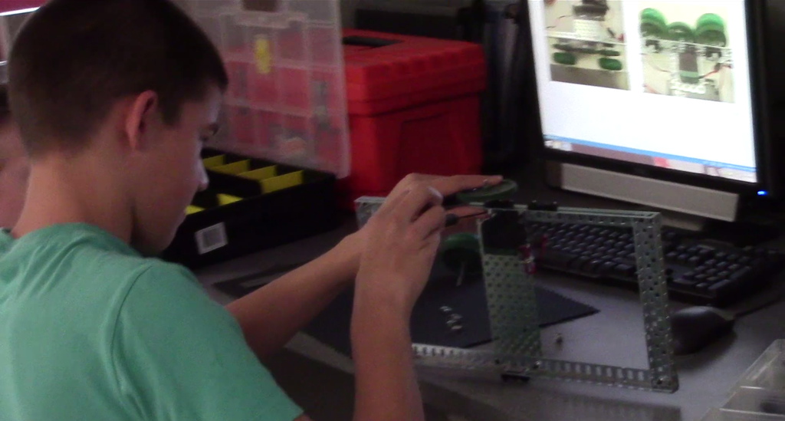
We Believe…
Learning should be student-centered; students should be given a voice and a choice.
Students should be challenged with learning opportunities that sustain inquiry.
Students should be creative, critical thinkers, problem solvers, and communicative collaborators.
Notes:
So… why adopt a digital 1:1 initiative? Why Access Oak Ridge?
This initiative is rooted firmly in a set of 10 beliefs:
(Read beliefs)

Slide 7
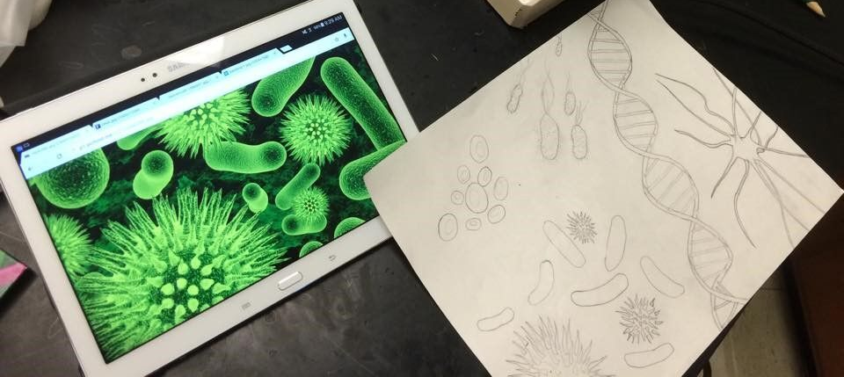
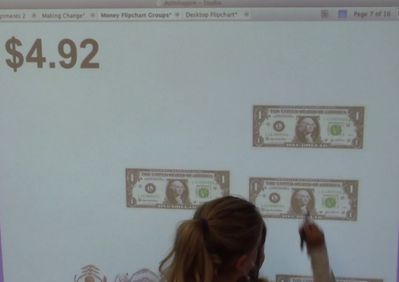
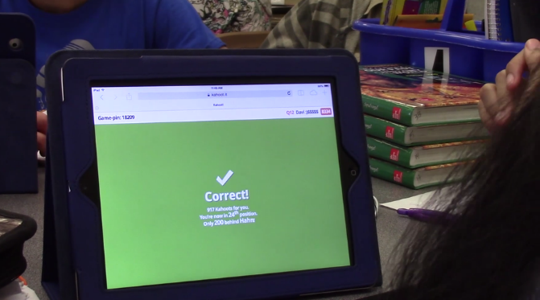
We Believe…
Teachers should set the stage for students to be engaged in real-world problem solving.
As physical education energizes bodies, a digital education energizes minds ready for the future.
The future of education and business exists in a digital world.
Students are being prepared for jobs that currently do not exist.
Notes:
(Read beliefs)

Slide 8
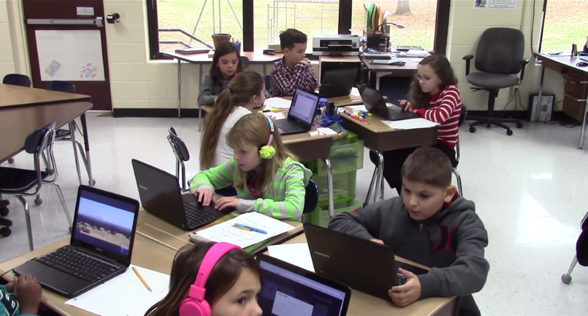
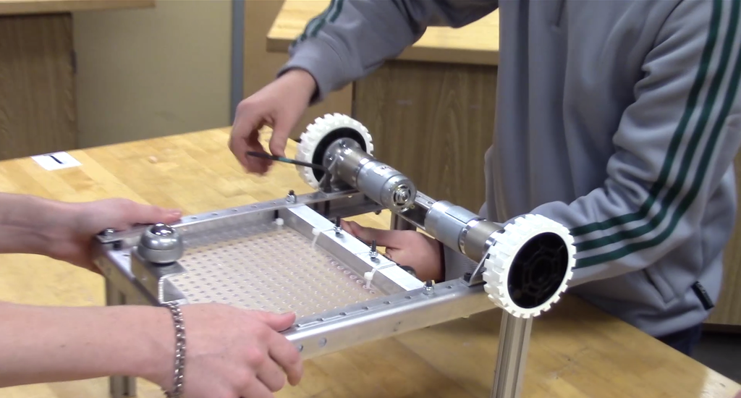
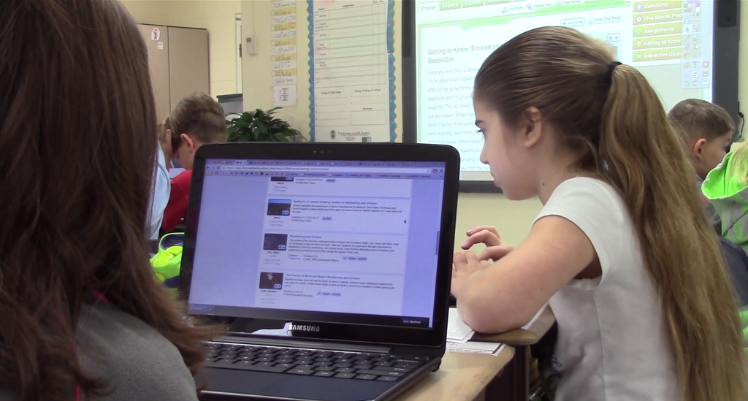
We Believe…
Technology enables students to explore content with greater depth and breadth.
The use of technology should allow for new learning tasks that were previously inconceivable.
Providing digital tools for our students levels the playing field and offers them opportunities to access a wealth of global information that is not locally accessible.
Notes:
(Read beliefs)

Slide 9
To Receive a Technology Device
Parents/Guardians must attend the training and information session, and must complete all required paperwork.
The ORS Technology Device Agreement and the CELA form must be completed before a device will be issued to the student

Slide 10
The Technology Device
Lenovo Yoga 11e
11.6” touch screen
3.3 pounds
128GB memory
2 USB Ports
7.5 hour battery life
Your “technology device” includes:
Laptop
Charger
Protective Covering (provided by school)
Notes:
Person A

Slide 11
Device Care & Maintenance
http://www.powtoon.com/online-presentation/ekSPGi2FlmW/
The technology device you are issued today will be returned at the end of the school year for summer updates and maintenance.
You will receive the same technology device at the beginning of the next school year. You are highly encouraged to take care of the laptop and all accessories you receive.

Slide 12
Device Care & Maintenance
Students should NEVER pick up the technology device by the lid. Students should close the technology device before it is picked up.
Each student will be expected to use the school issued protective case when traveling through the school building.
When carrying the device to and from school campus, it is advised that the device be placed in the case then inside a backpack or bag.
Students should be cautious when riding the bus and place the laptop in the top shelf of the lockers.

Slide 13
Device Use
The technology device is the property of the Oak Ridge Schools and may be collected and inspected at any time. Students have no right to privacy for any material on a district technology device.
Students are responsible for using the technology device according to school and district policies and procedures.
Each technology device has a unique serial number and asset tag. Students should not modify or remove the tag. Students should not write on, draw on, or add stickers or labels directly to the technology device. No other form of tampering will be permitted.

Slide 14
Device Use
If a student’s technology device is not working or is damaged, students should report the problem immediately to the help desk.
It is the student’s responsibility to back up projects and content. Students may want to purchase a flash drive for this task or plan to store their materials in Office365 or Google Drive.

Slide 15
Return of Device
The Technology Device is the property of Oak Ridge Schools.
Students who withdraw from school or, are suspended or expelled, must return their school technology device on the date of termination.
If a family fails to return the technology device at the end of the school year or upon termination of enrollment, the family will be subject to a fine for replacement cost of the technology device.

Slide 16
Device Damage, Theft or Loss
The Technology Device is the property of Oak Ridge Schools.
The student & family will be responsible for any damage to the technology device, charger or protective covering. If the device is damaged, a $50 damage penalty will be assessed. The student will then become a day user until the damage penalty is paid in full.

Slide 17
Device Theft, Loss or Non-preventable Damage
The Technology Device is the property of Oak Ridge Schools.
If a student’s technology device is lost or stolen at school, the student should report the loss immediately to the school administration.
If a student’s technology device is lost or stolen outside of school, families should report the loss immediately to the local police and obtain a police report. This report is required to document theft.
Non-preventable damage must also be reported to school administration.
School administration will meet with families to investigate the theft or non-preventable damage and finalize next steps.

Slide 18
Device Preventable Damage
The Technology Device is the property of Oak Ridge Schools.
Today, there is no cost to families for the technology device; however, upon accepting the technology device, families agree to pay a damage penalty of $50 if the technology device is damaged.
Please report all preventable damage or negligence within one week of a student’s return to school.
An administrator will meet with the family to investigate the incident.
The student will become a day user until the $50 damage penalty is received.

Slide 19
Willful Device Damage/Negligence
The Technology Device is the property of Oak Ridge Schools.
An administrator will meet with the family to investigate the incident. Intentional damage to the device will lead to disciplinary consequences.
Also, the student will become a day user at that point.
The replacement of the device cannot be satisfied by families themselves purchasing their own replacement device.
The cost of repairs will be assessed for each reported incident.
Multiple offenses should be handled appropriately and in consultation with the district office as necessary.

Slide 20
Internet Safety
Oak Ridge Schools are currently using the iBoss Internet Filter. This filter should apply at home as well when students log on to their devices.
Teachers will use the LAN School program to monitor student laptop use in the classroom.
At home you can do the following to help keep your child safe:
Monitor at home internet use.
Use the internet with your child and ask questions about school issued programs.
Provide an open area in the home where the device can be used such as a kitchen table or family room space.
Ask to see your student’s device and ask how it is being used.

Slide 21
Opting Out
If parents or guardians do not want their children to take devices home, students can become day users of the device.
They would then need to check out the device at the beginning of the school day and check in the device at the end of the school day.

Slide 22
Device Use in the Classroom
Teachers have received training in various digital instructional tools, including our Learning Management System (Canvas), software programs for their content area, and digital textbooks.
Teachers can choose to use the device or not on any particular day in their classroom, but most teachers are excited about students having access to devices. Bring Your Own Device (BYOD) has not been as successful because of the different devices that students own and because some students don’t have devices.
Going one-to-one allows every student to have access to digital content on the same platform.
It’s also important to remember that our state is requiring online testing in English Language Arts, math and social studies starting this February.

Slide 23
Device Use in the Classroom
Devices will be loaded with digital textbooks and commonly used software for the student’s grade level.

Slide 24
Today’s Agenda for Device Deployment
Check In
Attend Opening Session
Device policies
Internet Safety & Digital Citizenship
Device Paperwork Submission
Blue Team Assigned Rooms
Gold Team Assigned Rooms
Device Pick up
Test Device and Programs Log-in

